Slide 1


Electric Field, Electric Field due to point charge and dipole
Chapter 22:Electric Fields

Slide 2
22-1 The Electric Field
Learning Objectives
22.01 Identify that at every point in the space surrounding a charged particle, the particle sets up an electric field E, which is a vector quantity and thus has both magnitude and direction.
22.02 Identify how an electric field E: can be used to explain how a charged particle can exert an electrostatic force F on a second charged particle even though there is no contact between the particles.
22.03 Explain how a small positive test charge is used (in principle) to measure the electric field at any given point.
22.04 Explain electric field lines, including where they originate and terminate and what their spacing represents.

Slide 3
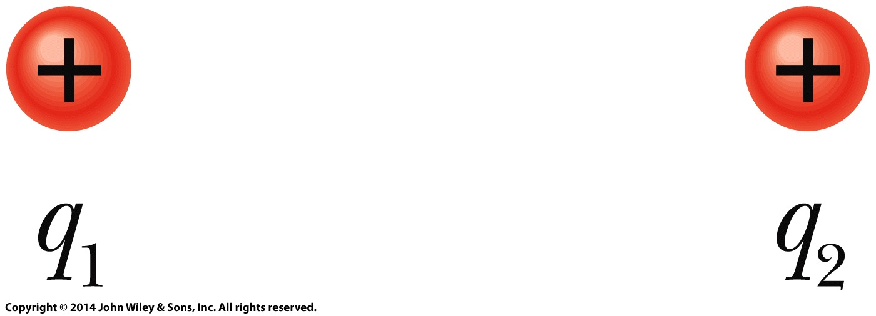
22-1 The Electric Field
?
How does particle 1 “know” of the presence of particle 2? That is, since the particles do not touch, how can particle 2 push on particle 1—how can there be such an action at a distance?

Slide 4
22-1 The Electric Field
Electric Field
The explanation that we shall examine here is this: Particle 2 sets up an electric field at all points in the surrounding space, even if the space is a vacuum. If we place particle 1 at any point in that space, particle 1 knows of the presence of particle 2 because it is affected by the electric field particle 2 has already set up at that point. Thus, particle 2 pushes on particle 1 not by touching it as you would push on a coffee mug by making contact. Instead, particle 2 pushes by means of the electric field it has set up.

Slide 5
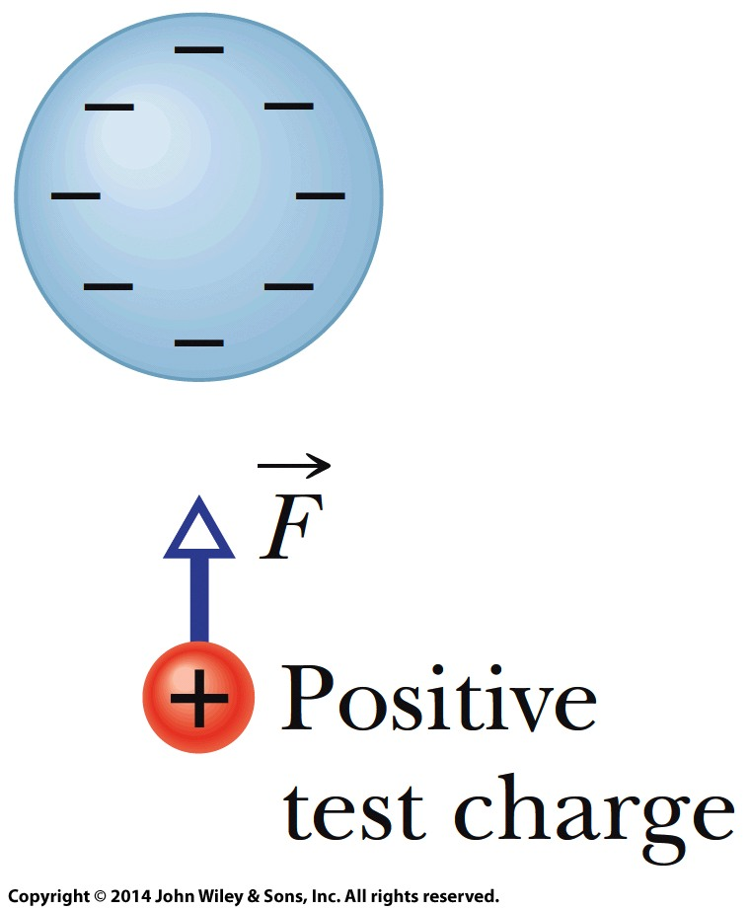

22-1 The Electric Field
Electric Field
The electric field E at any point is defined in terms of the electrostatic force F that would be exerted on a positive test charge q₀ placed there:

Slide 6
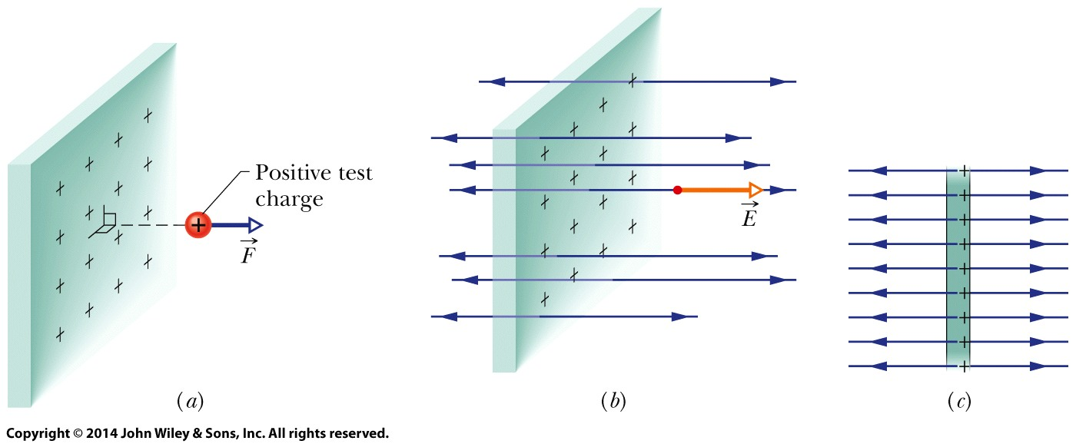
22-1 The Electric Field
Electric Field Lines
Electric field lines help us visualize the direction and magnitude of electric fields. The electric field vector at any point is tangent to the field line through that point. The density of field lines in that region is proportional to the magnitude of the electric field there.
(a) The force on a positive test charge near a very large, non-conducting sheet with uniform positive charge on one side. (b) The electric field vector E at the test charge’s location, and the nearby electric field lines, extending away from the sheet. (c) Side view.

Slide 7

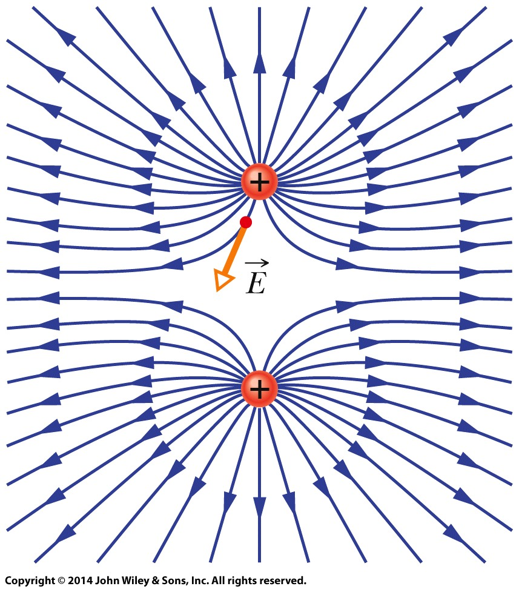
22-1 The Electric Field
Electric Field Lines
The electric field vector at any given point must be tangent to the field line at that point and in the same direction, as shown for one vector.
A closer spacing means a larger field magnitude.
Field lines for two particles with equal positive charge. Doesn’t the pattern itself suggest that the particles repel each other?

Slide 8
22-2 The Electric Field Due to a Charged Particle
Learning Objectives
22.07 For a given point in the electric field of a charged particle, apply the relationship between the field magnitude E, the charge magnitude |q|, and the distance r between the point and the particle.
22.08 Identify that the equation given here for the magnitude of an electric field applies only to a particle, not an extended object.
22.09 If more than one electric field is set up at a point, draw each electric field vector and then find the net electric field by adding the individual electric fields as vectors (not as scalars).
22.05 In a sketch, draw a charged particle, indicate its sign, pick a nearby point, and then draw the electric field vector E: at that point, with its tail anchored on the point.
22.06 For a given point in the electric field of a charged particle, identify the direction of the field vector E: when the particle is positively charged and when it is negatively charged.

Slide 9
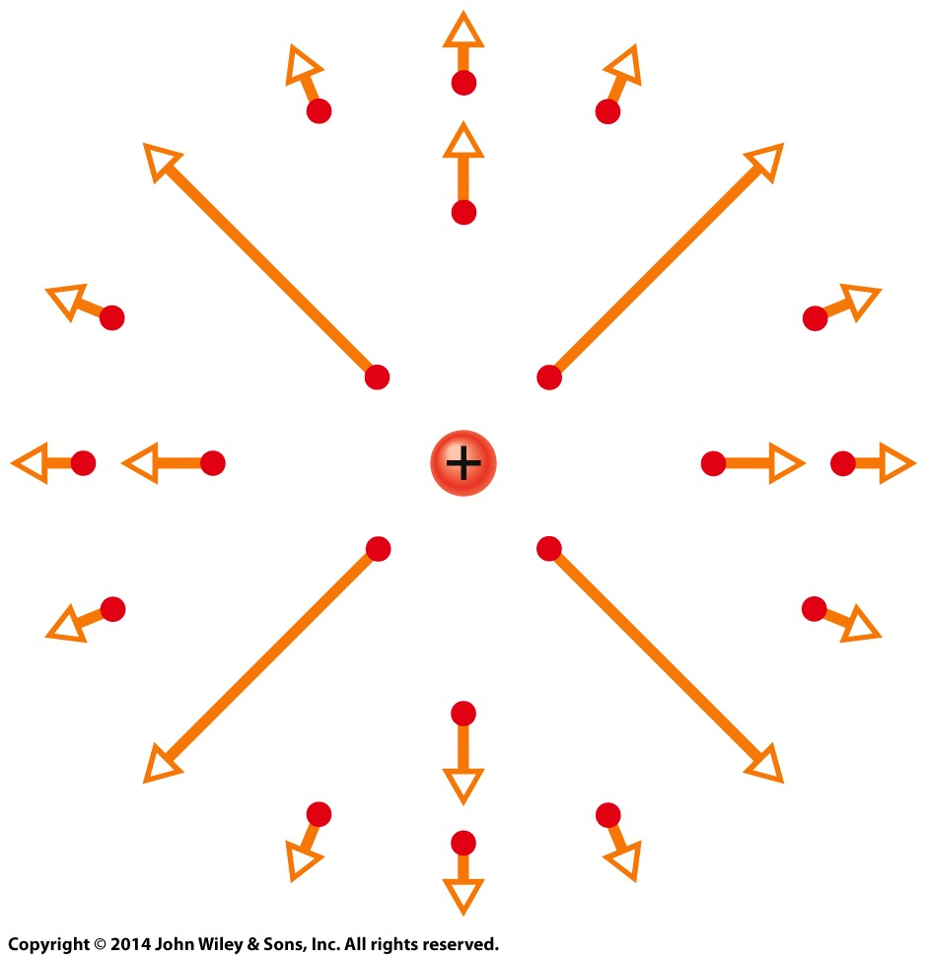

22-2 The Electric Field Due to a Charged Particle
The magnitude of the electric field E set up by a particle with charge q at distance r from the particle is
The electric field vectors set up by a positively charged particle all point directly away from the particle. Those set up by a negatively charged particle all point directly toward the particle.
If more than one charged particle sets up an electric field at a point, the net electric field is the vector sum of the individual electric fields—electric fields obey the superposition principle.
The electric field vectors at various points around a positive point charge.

Slide 10
22-3 The Electric Field Due to a Dipole
Learning Objectives
22.10 Draw an electric dipole, identifying the charges (sizes and signs), dipole axis, and direction of the electric dipole moment.
22.11 Identify the direction of the electric field at any given point along the dipole axis, including between the charges.
22.12 Outline how the equation for the electric field due to an electric dipole is derived from the equations for the electric field due to the individual charged particles that form the dipole.
2.13 For a single charged particle and an electric dipole, compare the rate at which the electric field magnitude decreases with increase in distance. That is, identify which drops off faster.

Slide 11
22-3 The Electric Field Due to a Dipole
Learning Objectives (Contd.)
22.14 For an electric dipole, apply the relationship between the magnitude p of the dipole moment, the separation d between the charges, and the magnitude q of either of the charges.
22.15 For any distant point along a dipole axis, apply the relationship between the electric field magnitude E, the distance z from the center of the dipole, and either the dipole moment magnitude p or the product of charge magnitude q and charge separation d.

Slide 12
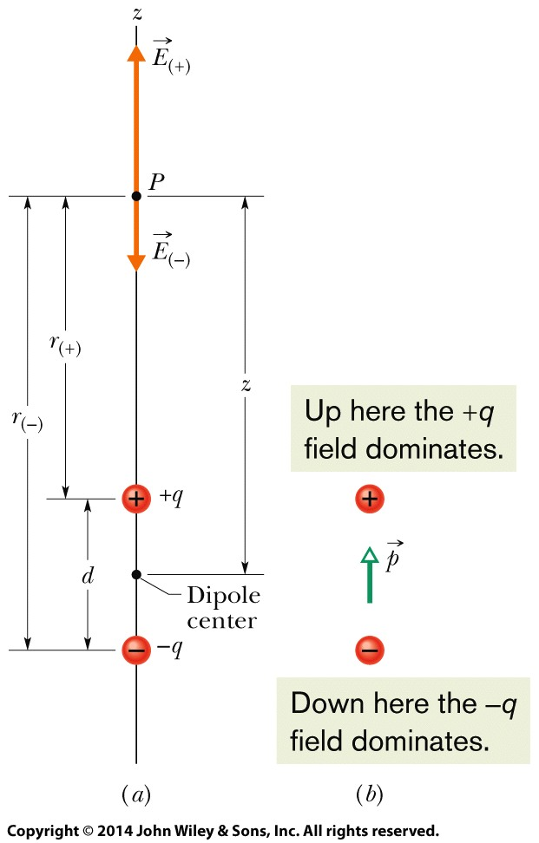

22-3 The Electric Field Due to a Dipole
Electric Dipole
An electric dipole consists of two particles with charges of equal magnitude q but opposite signs, separated by a small distance d.
The magnitude of the electric field set up by an electric dipole at a distant point on the dipole axis (which runs through both particles) can be written in terms of either the product qd or the magnitude p of the dipole moment:
where z is the distance between the point and the center of the dipole.

Slide 13




22 Summary
Definition of Electric Field
The electric field at any point
Field due to an Electric Dipole
The magnitude of the electric field set up by the dipole at a distant point on the dipole axis is
Eq. 22-1
Electric Field Lines
provide a means for visualizing the directions and the magnitudes of electric fields
Eq. 22-9
Field due to a Charged Disk
The electric field magnitude at a point on the central axis through a uniformly charged disk is given by
Field due to a Point Charge
The magnitude of the electric field E set up by a point charge q at a distance r from the charge is
Eq. 22-26
Eq. 22-3

Slide 14
22 Summary
Force on a Point Charge in an Electric Field
When a point charge q is placed in an external electric field E
Dipole in an Electric Field
The electric field exerts a torque on a dipole
The dipole has a potential energy U associated with its orientation in the field
Eq. 22-34
Eq. 22-28
Eq. 22-38

